Slide 1
Week 4: Frontend Development with Next.js (Part 2)
UML cloud computing club

Slide 2
Announcements
Guest speakers confirmed! See schedule for details
UniPath.io Progress
Agenda:
  Continue Next.js
  Why Next.js
  Intro to Next.js
  Building a UI in Next.js

Slide 3
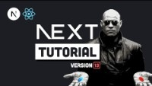
Next.js – The Basics: https://www.youtube.com/watch?v=__mSgDEOyv8

Slide 4

Demo: Intro to next.js
Let’s generate a new Next.js project and explore how it works

